Slide 1
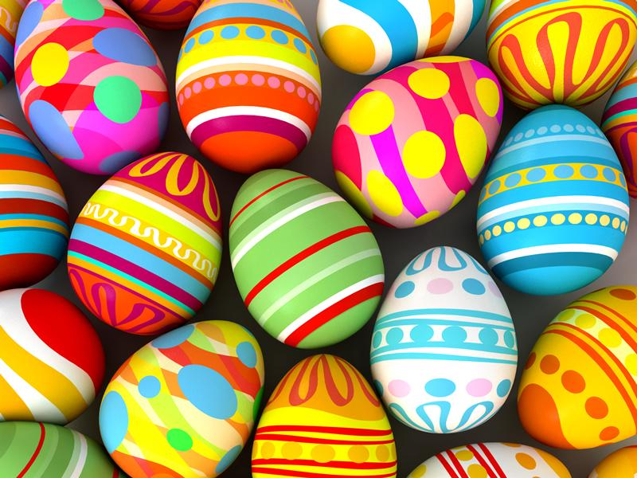
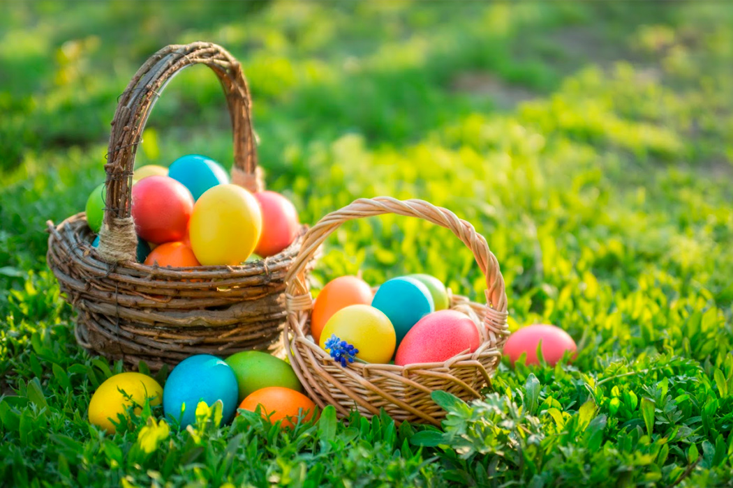
Polish Easter Traditions
By Nikodem Marcinkiewicz

Slide 2
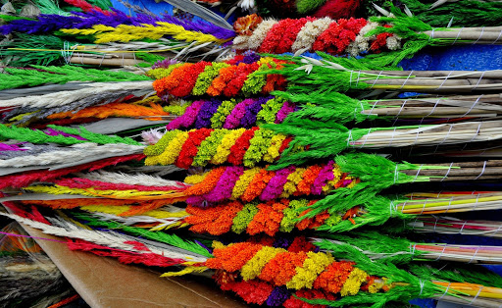
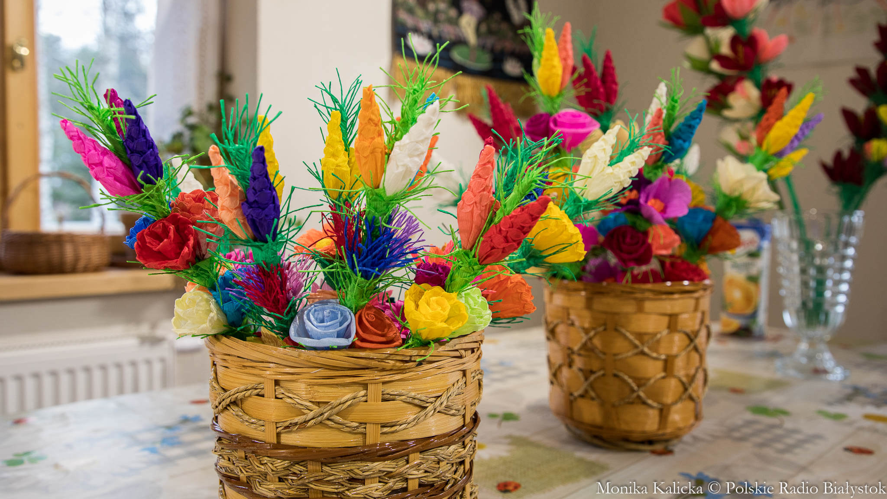
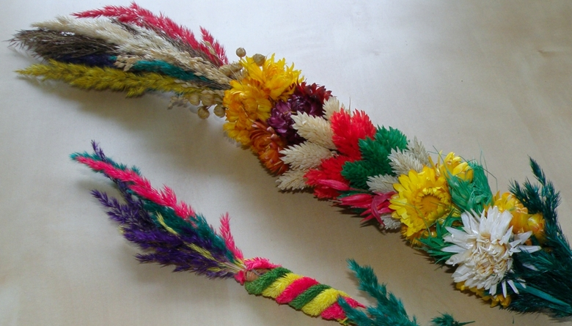
Palm Sunday
Palm Sunday opens the Holy Week. In this day the Polish are making palms which look like that:
Then in church they hallow them and after the mass they keep them in house to the Easter Sunday

Slide 3
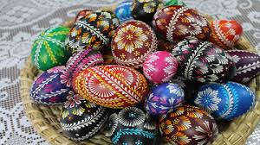
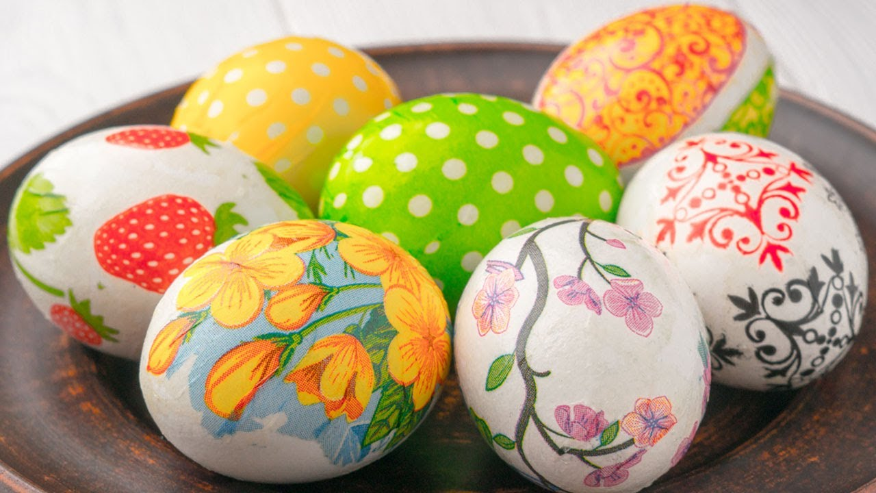
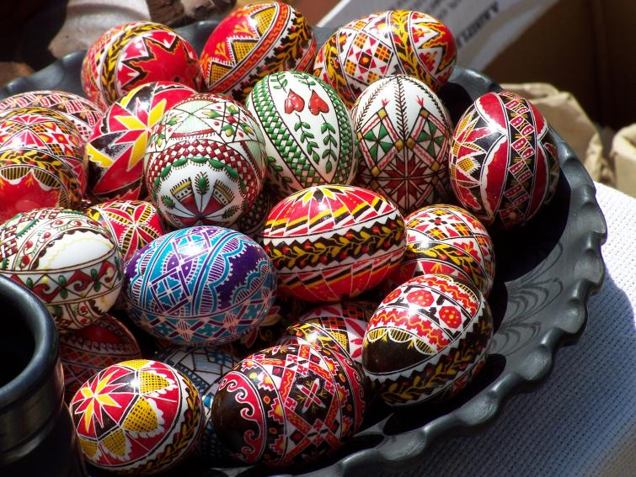
Painting the Easter eggs
It’s one of the oldest polish traditions. People put the eggs to the basket and take it to the Easter Basket event in church. After that in home they hallow it there and during the Easter Sunday, they share it between each other. Sometimes there are tournaments between the best eggs.

Slide 4
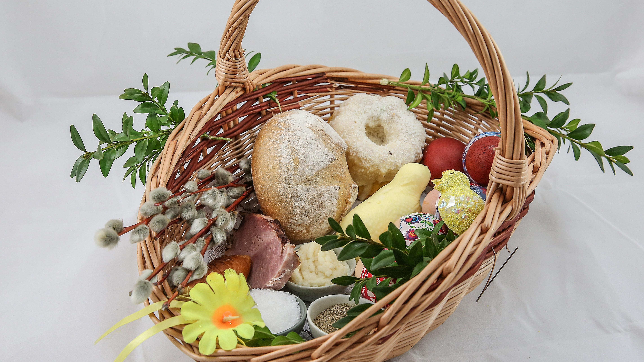
Easter Basket
During Holy Saturday people are going to church to hallow food in basket.
In basket we should have:
Eggs (they may be colored)
Bread
Sausage and cooked meats
Salt and pepper
Horseradish
Cake

Slide 5
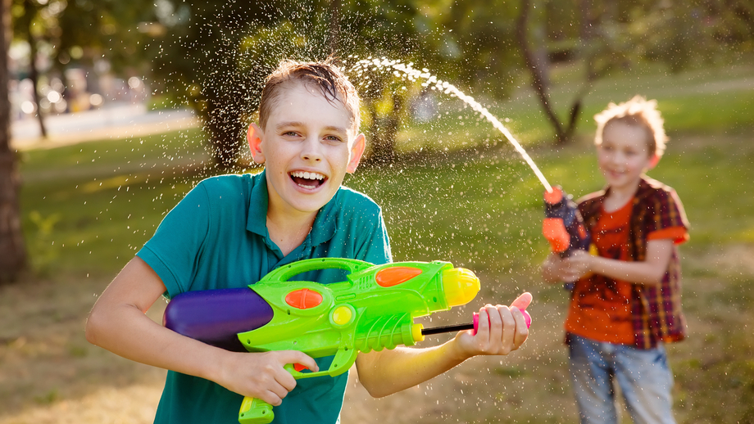
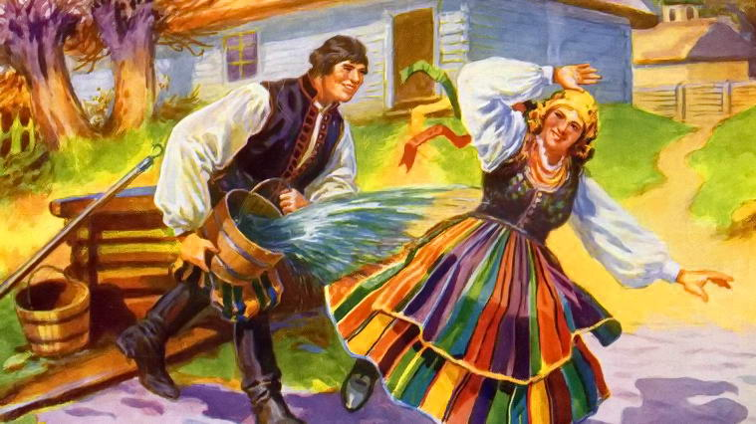
Śmigus Dyngus
It’s actually as old as Easter eggs tradition. The play is about pouring other people with water. Today people are using plastic water guns or plastic eggs which are able to shooting water. Often in older villages people are using buckets so then it’s really humidly.

Slide 6
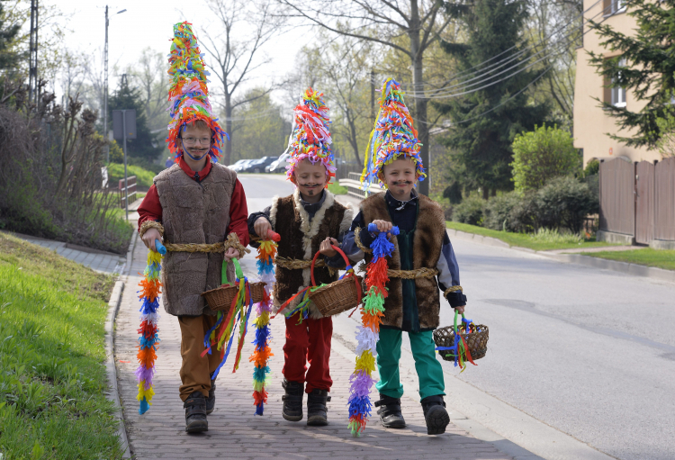
The less common tradition: It’s only in villages near Cracow - Pucheroki
Pucherki is the event during the Palm Sunday. The peasants are dress up like that:
They’re walking across the village and thet’re singing during this. Some of them are asking for a little money.

Slide 7
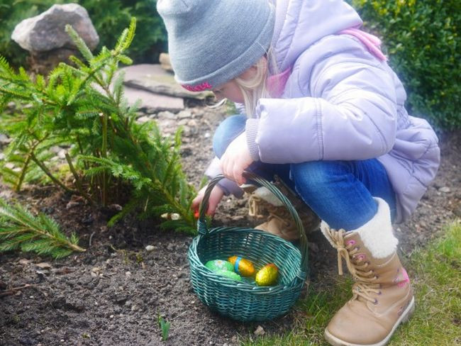
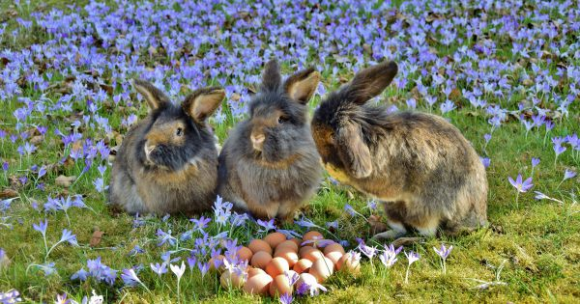
Newer tradition is looking for presents from Easter Bunny
After the Easter Sunday breakfast, children are looking for gifts from Easter Bunny. The gifts are not as big as during Christmas beacause they are more symblic.

Slide 8
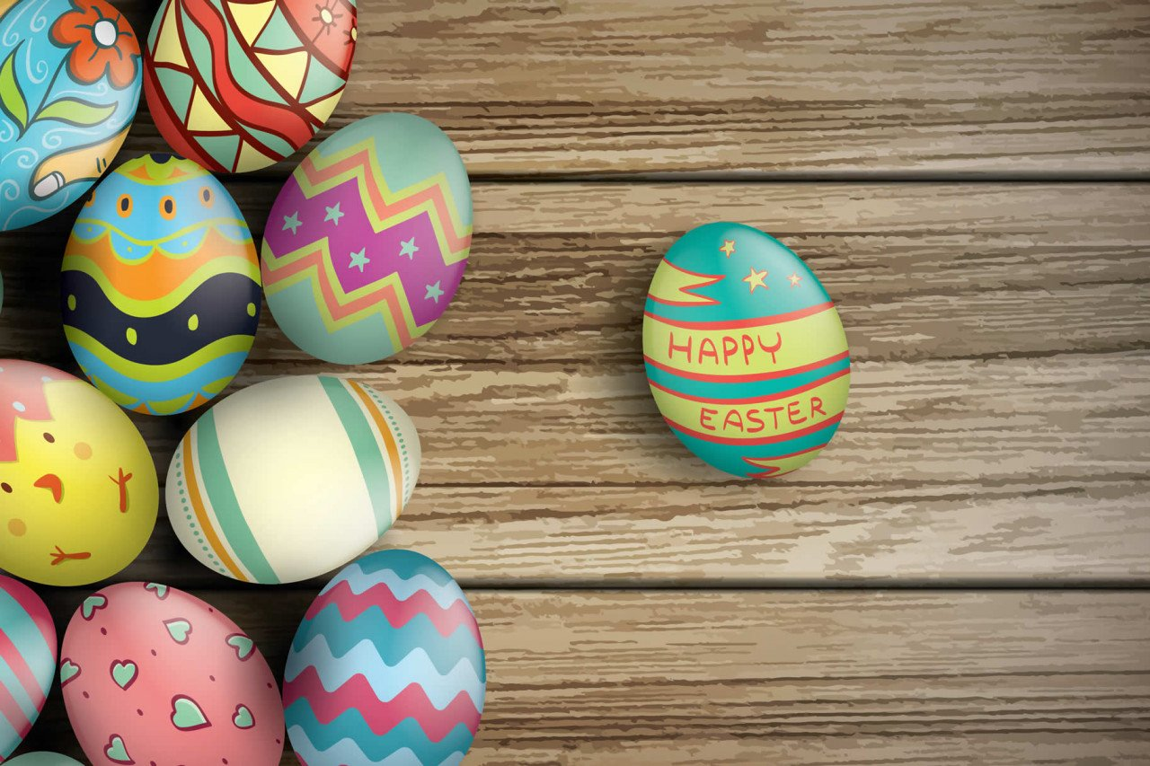
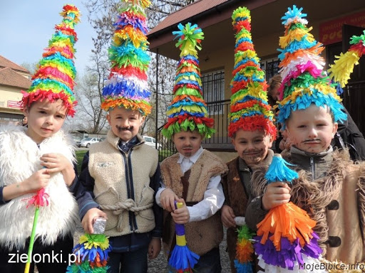
The end
Sources:
https://podroze.onet.pl/ciekawe/polskie-tradycje-wielkanocne/eyc53ds

