Slide 1
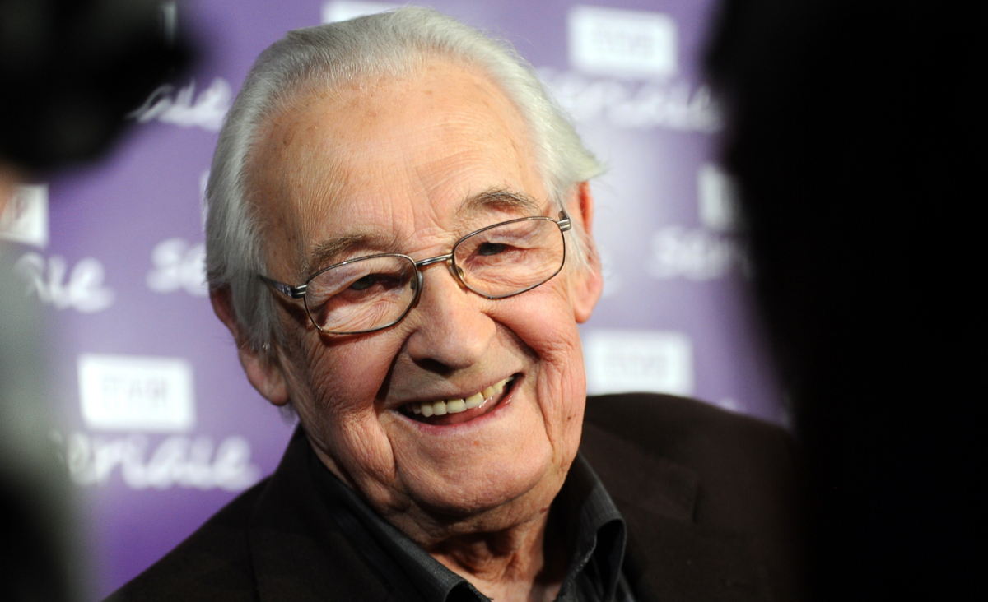
Andrzej Wajda

Slide 2
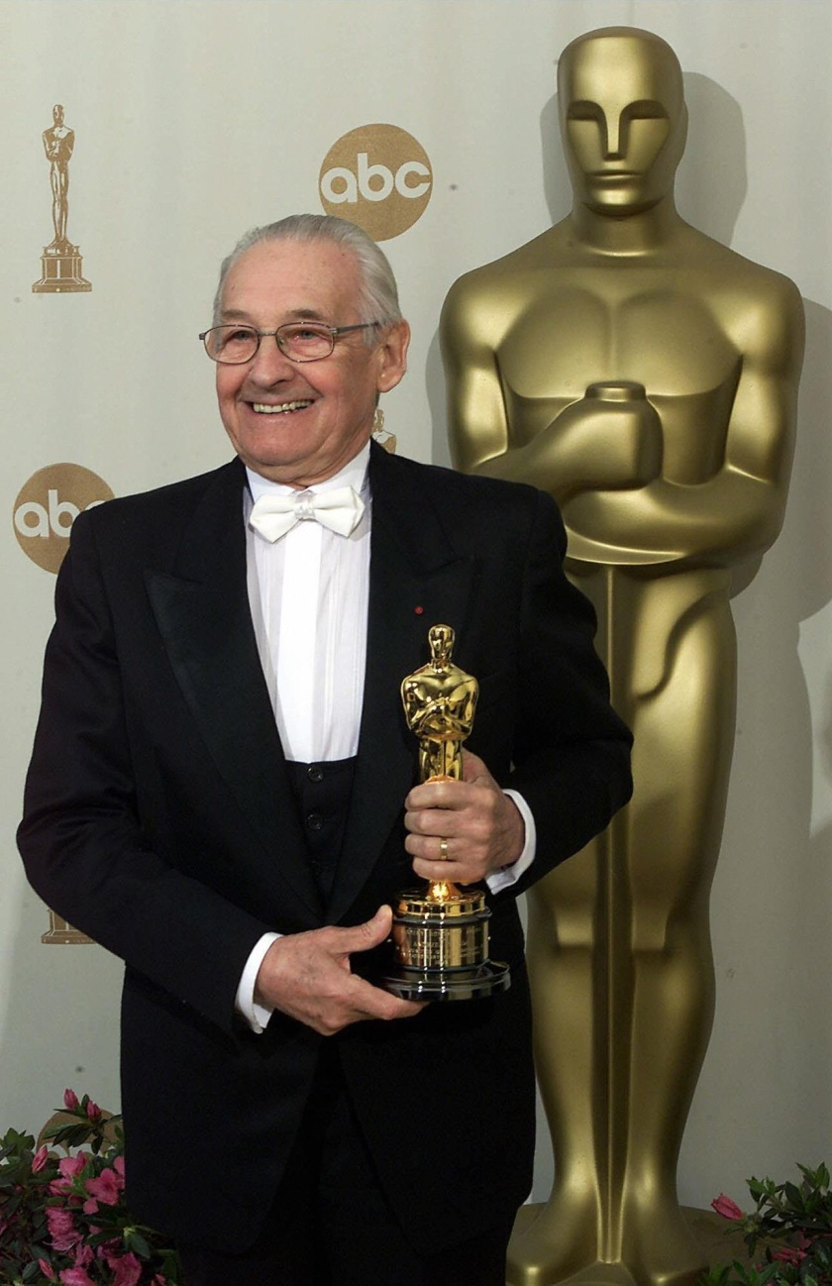
Andrzej Witold Wajda was born in March 6, 1926 in Suwałki, he died in October 9, 2016 in Warsaw, at the age of 90. He was Polish film and theater director.
He was nominated four times for the Academy Award for Best Foreign Language Film. He was the Knight of the Order of the White Eagle.
His work referred to Polish symbolism and romanticism. He was awarded many times for his contribution to the development of cinematography, including in 2000 when he received the lifetime achievement Academy Award.

Slide 3
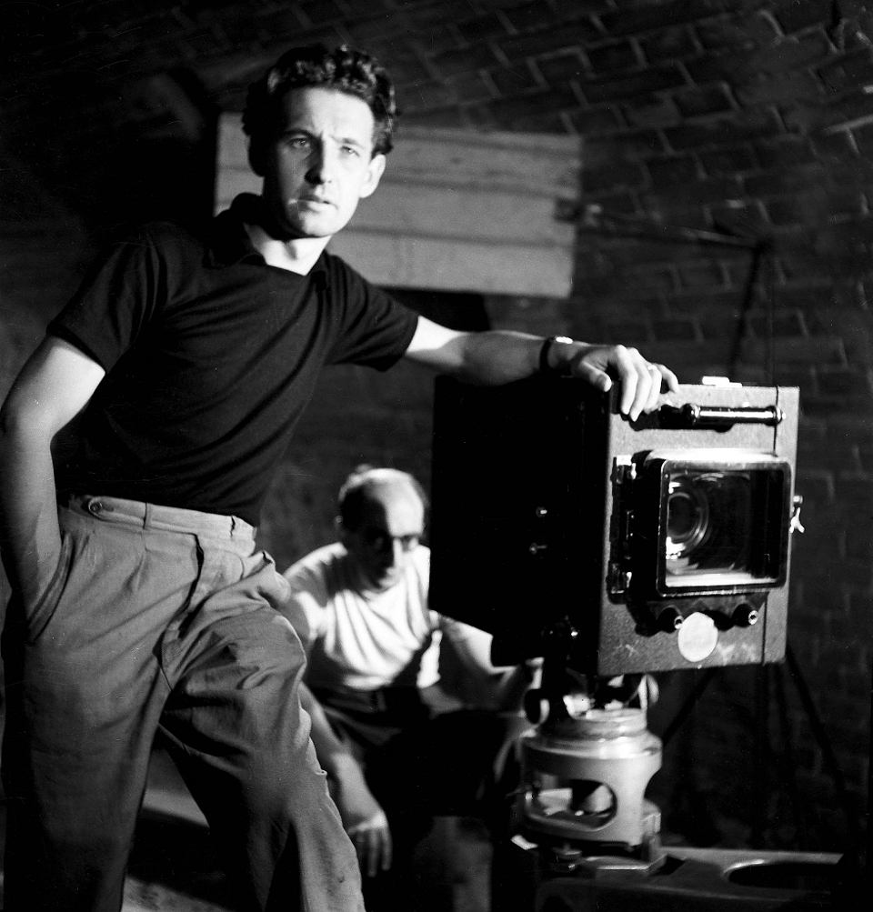
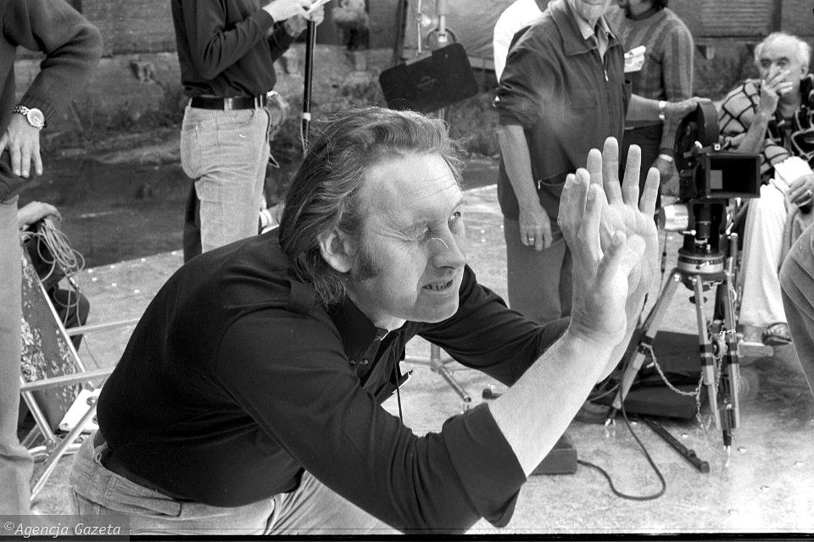
His family came from the village of Szarów. His father was an officer in the Polish Army. His mother was a teacher, she graduated from teachers' college. She taught at a Ukrainian school.
It was a typical intellectual marriage. His father was promoted quite quickly and was transferred to Suwałki, to the Garrison of the 41st Infantry Regiment. And that's where Andrzej Wajda was born.
Then Wajda’s family moved to Radom. Wajda’s father died at age of 40. He was the captain of the 72nd Infantry Regiment and died in Katyń. He wanted his son to serve in the army.

Slide 4
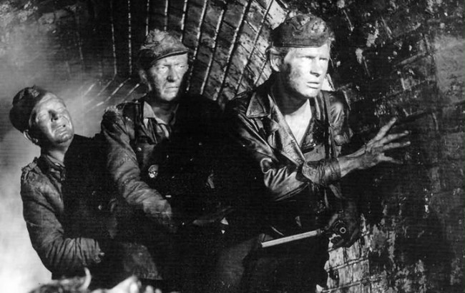
In 1939, Wajda went to Lwów to join the Cadet Corps. However, he did not get there and spent most of the war in Radom. First, after the war, he went to Kraków, because he thought that the Academy of Fine Arts in Kraków was his destiny. In 1946, Andrzej Wajda began painting studies. After three years, however, he gave up painting and chose film - in 1949 because there was a Film School in Łódź - the only one that was established then, and it seemed to him that this was his place. He made his debut as a director in 1955 with "Pokolenie". Wajda's second self-made film, “Kanał” in 1956, a story about Warsaw insurgents, brought international success.

Slide 5
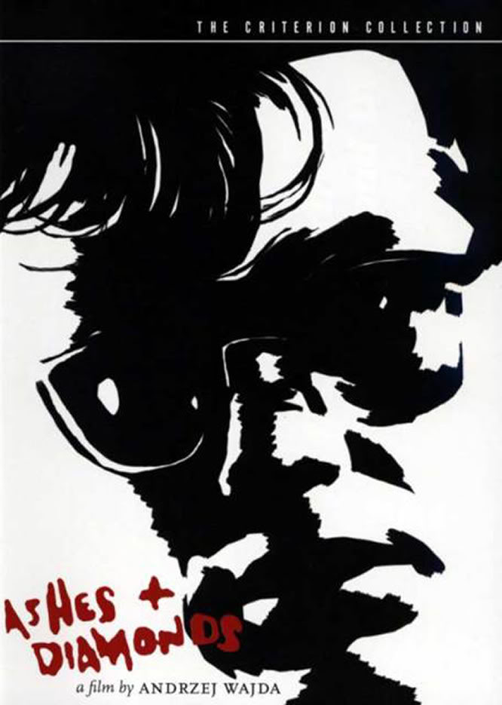
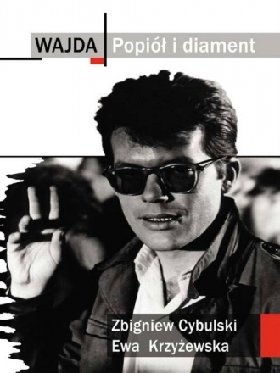
Another success was "Popiół i Diament" in 1958, with the unforgettable performance of Zbigniew Cybulski, awarded at the International Film Festival in Venice. The films accounted for the times of World War II.

Slide 6
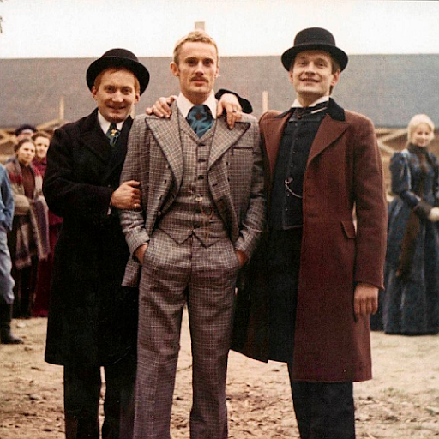
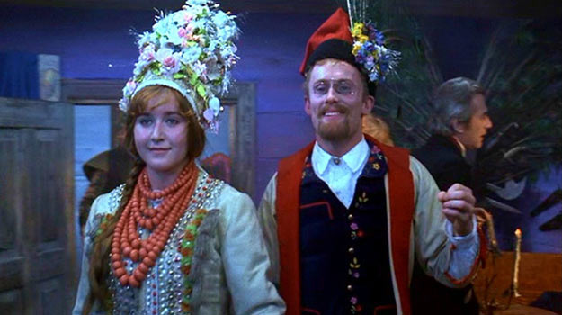
In 1973 the director transferred Stanisław Wyspiański's drama "Wesele" to the screen, and two years later Reymont's "Ziemia Obiecana", which was recognized by critics as Wajda's best film - the film was nominated for an Oscar.

Slide 7
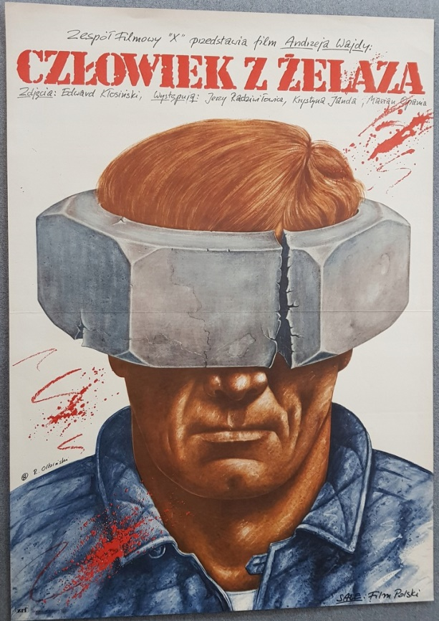
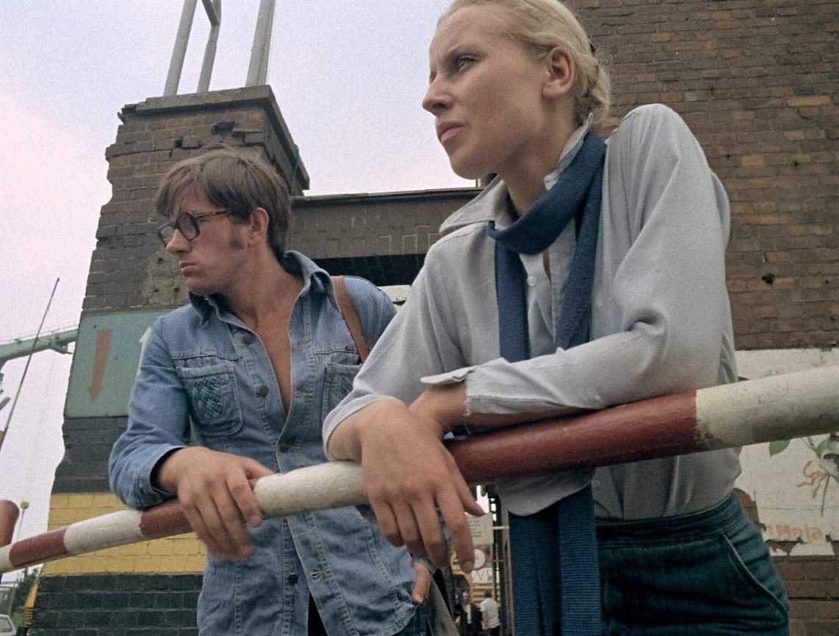
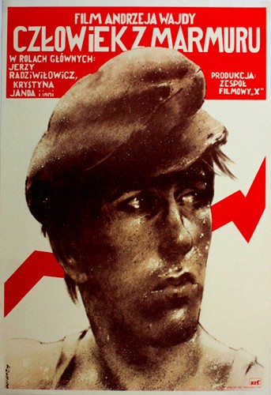
He directed “Człowiek z Marmuru” and its continuation “Człowiek z Żelaza”, with Jerzy Rzadziwiłowicz and Krystyna Janda. They were awarded at the Cannes festiwal.

Slide 8
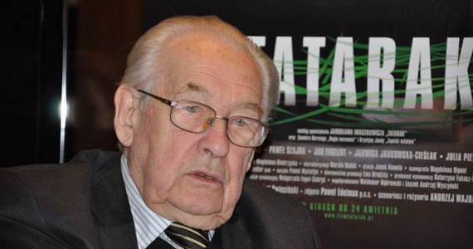
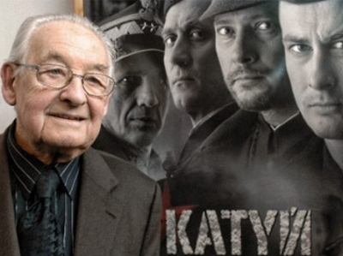
Then he moved from Łódź to Warsaw. And then back to Kraków, because the Old Theater was there.
In the 1989/1990 season Andrzej Wajda was an artistic director of the Powszechny Theater in Warsaw.
for an Oscar.
The artist's latest achievements: In 2007 he made "Katyń", and in 2009 experimental "Tatarak", which was awarded with the Alfred Bauer at the International Film Festival in Berlin, "Katyń" was nominated for an Oscar.

Slide 9
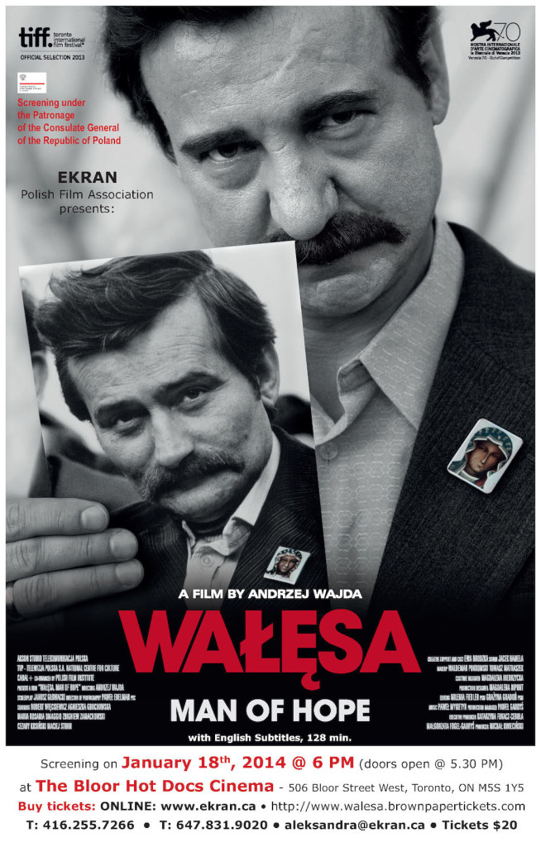
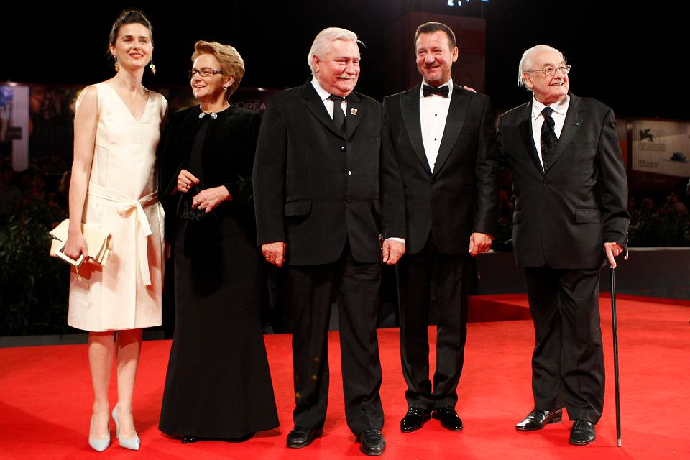
In 2008, the council of the Polish Katyń Foundation awarded him the Medal of the Day of Remembrance of the Victims of the Katyń Massacre, but Andrzej Wajda did not accept this award. In September 2013 he made "Wałęsa. Man of Hope". The main roles were played by Robert Więckiewicz, who played Lech Wałęsa, and Agnieszka Grochowska, as Danuta Wałęsa.

Slide 10
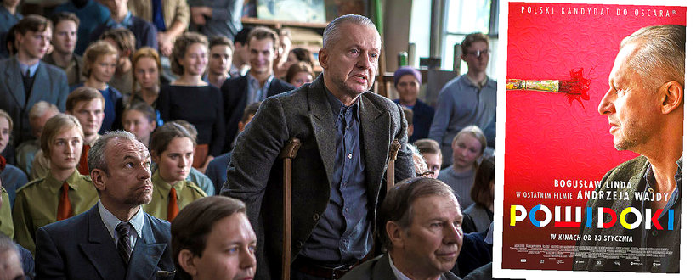
In September 2016, at the Gdynia festival, a special screening of Wajda's last film "Powidoki" with Bogusław Linda in the lead role was held. During the ceremony preceding the screening at the Wajda Music Theater, actors who had collaborated with him on various films thanked the audience.

Slide 11
Literatura:
https://pl.wikipedia.org/wiki/Andrzej_Wajda
http://www.wajda.pl/pl/o_sobie.html
https://dzieje.pl/postacie/andrzej-wajda

Slide 12
The end

